Slide 1
Deploy and Verify YOLO v2 Vehicle Detector on FPGA
Sponsor – Kaushik Nagaranjan
Mentor – Divya Yerraguntla
Manager – Neeharika Yayavaram
Bharath Ranga
13-07-23

Slide 2
Agenda
Motivation and Aim of the project
Functional Design
Workflow
Simulate YOLO v2 network on FPGA using DL HDL Processing System
IP core and Bitstream generation from HDL Workflow Advisor
Compile and Deploy YOLO v2 Deep Learning Network on FPGA
Challenges faced
Exploratory work on YOLO v2 SoC example
Conclusion
Learnings from the Project

Slide 3
Motivation and Aim of the project
DL HDL Toolbox currently has a shipping YOLOv2 system integration example.
This example shows an end-to-end workflow to integrate pre/post processing modules with manually designed DL IP Core.
It uses hard coded DL IP core is specific only to YOLO v2 network, there is no flexibility in terms of using different networks.
The customers who may want to use different networks need to design the example which takes so much time.
DL HDL Toolbox introduced Deep Learning HDL Processing system as part of 23b which is flexible to use for any network and Processor configuration.
Therefore, the aim of this project is to replace this DL IP Core with Deep Learning HDL Processing System

Slide 4
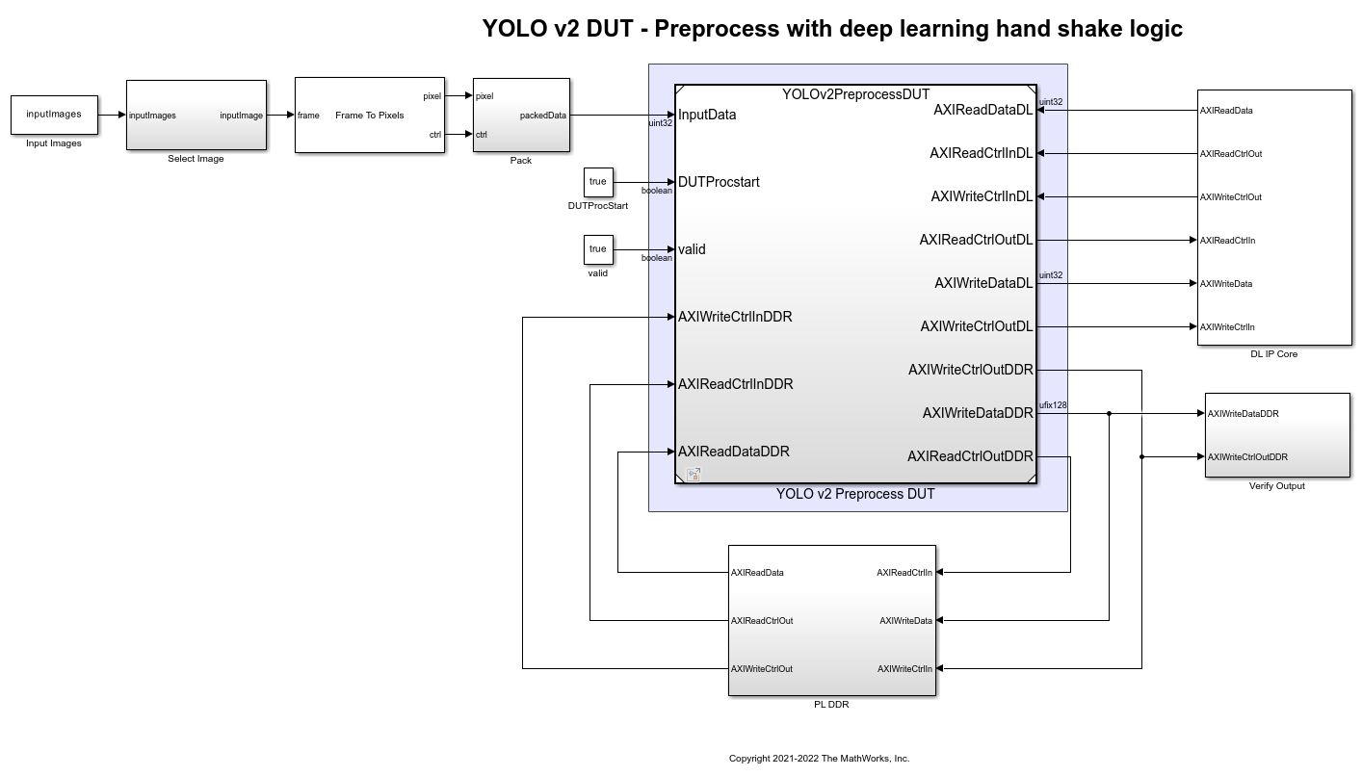
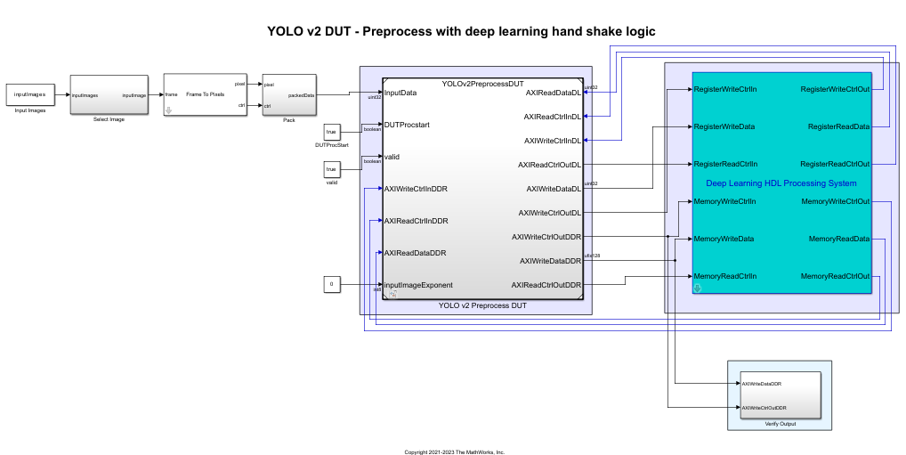
Functional Design
Replaced the "DL IP core + DDR" with DL HDL processing system.

Slide 5
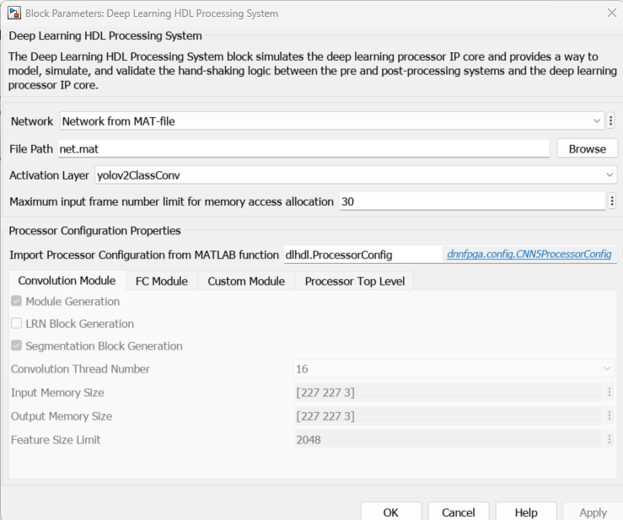
Functional Design
Replaced the "DL IP core + DDR" with DL HDL processing system.

Slide 6
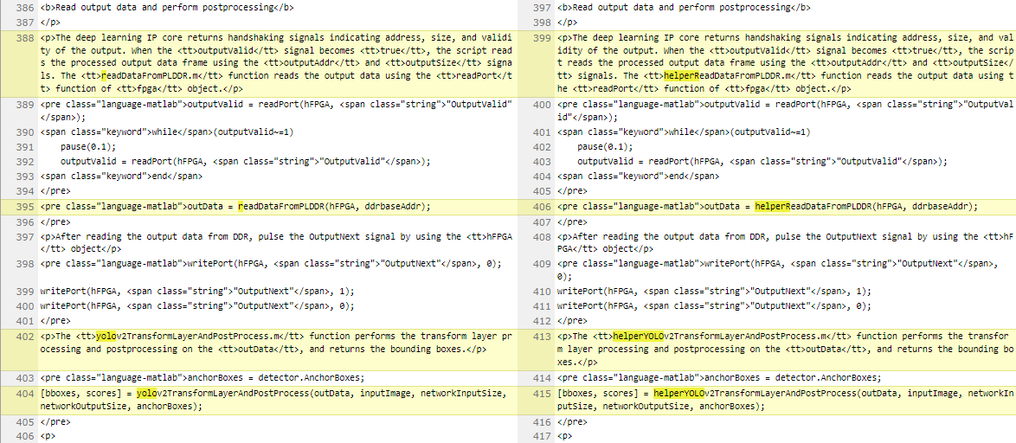
Functional Design
Updated the names of helper functions used in the network with ‘helper’ prefix according to PRISM standards

Slide 7
Functional Design
Fixed issue with dataset and network files are no longer being available in shared location
Added them to the example data directly
Xilinx Vivado version have been updated in the helper and HDL Workflow Advisor settings
Added resource information table to the example to show the resource consumption of the example

Slide 8
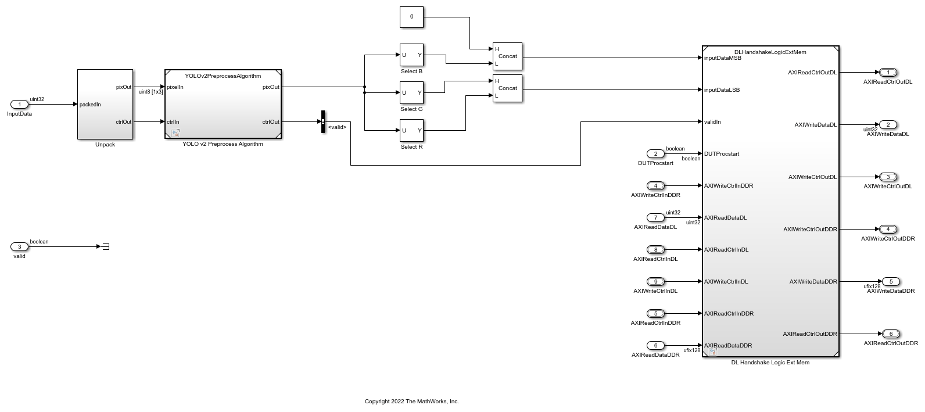
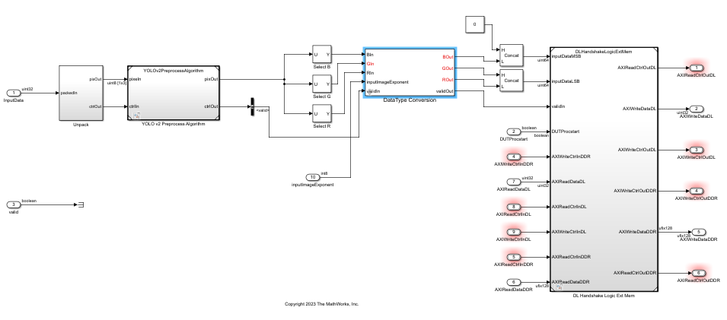
Functional Design
Updated the example to also support “int8” in the future releases (CL provided by Sivani).

Slide 9
Workflow
Replaced the DL IP Core and DDR with DL HDL Processing system
Generated the IP Core and bitstream using HDL Code > HDL Workflow Advisor
Compiled and Deployed YOLO v2 Deep Learning network on FPGA
Incorporated int8 related changes into the pre-processing module, simulated and verified the preprocessed output using helperPreprocessDUTVerify script.
Performed post-processing using helperyolov2TransformLayerandPostProcess() function and then verified the output using helperyolov2DeployandVerifyDetector(hSoC) function.

Slide 10
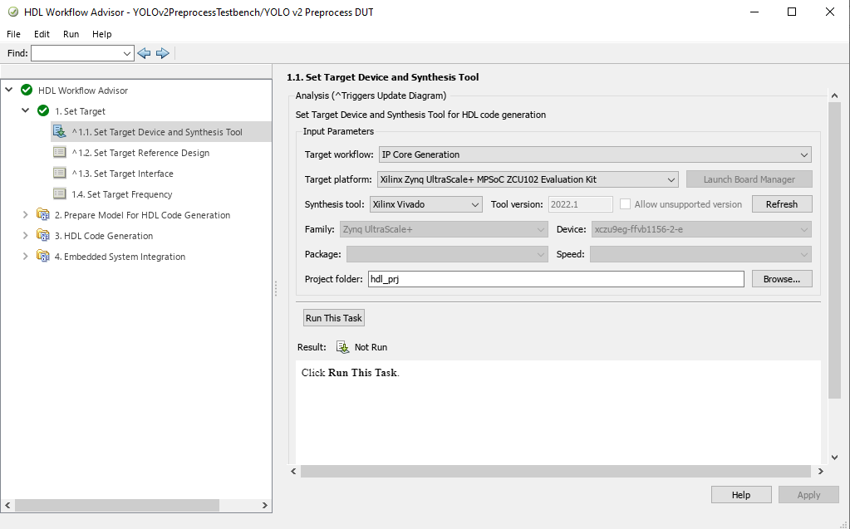
Generate and Deploy Bitstream to FPGA

Slide 11
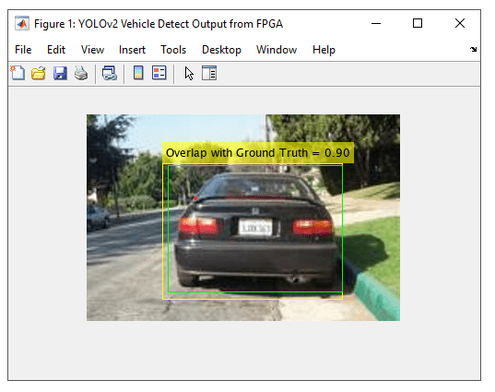
Post-processed output

Slide 12
Challenges faced
Issues related to the Support packages registration during the deployment of bitstream onto FPGA.
So many iterations due to the MATLAB version incompatibility between 24a and 23b during the bitstream generation and sometimes due to the changes not reaching the Bdoc sandbox.
Debugging issues caused by HDL coder optimisations in 23b:
OutputValid signal not getting pulsed.
Distorted pre-processed image being written to the DDR.
Comparing the expected and actual pre-processed image to find some pattern of mismatching.

Slide 13
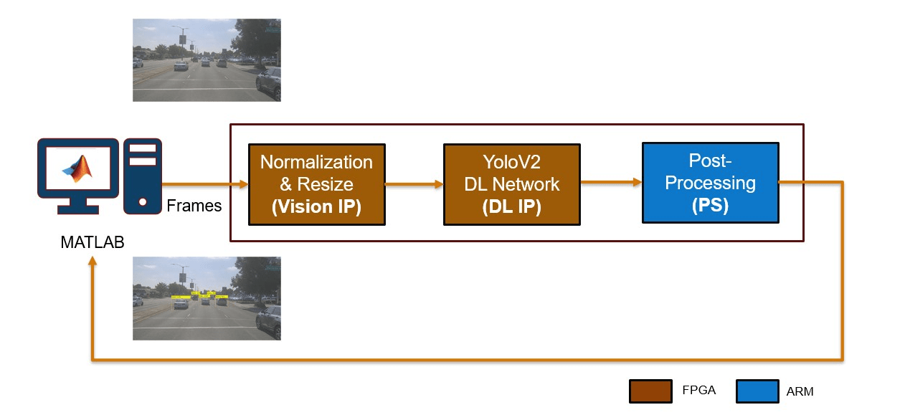
Exploratory work on YOLOv2 SoC example
YOLOv2 SoC example uses both pre and post processing modules on SoC.
Pre-processing subsystem is deployed to FPGA/ PL.
Post-processing subsystem is deployed to ARM processor/ PS.
Identified the limitations of Deep Learning HDL Processing System as it works only with PL.

Slide 14
Learnings from the Project
About DL HDL Toolbox and Generic DL HDL Toolbox workflow for object detection
Standard AXI Protocol​s
HDL Workflow Advisor
Generation and deployment of Bitstream onto FPGA
MATLAB, Simulink, Sandbox Manager, Perforce and Example Manager.
Component builds
Testing framework

Slide 15

Any Questions?

Slide 16

THANK YOU

